Slide 1
Neural Network Fundamentals
Multi-Layer Perceptron
Lecture 3
Part 2
Generative AI for Computer Vision

Slide 2
Content
Introduction to Multi-Layer Perceptron
Activation Function
Softmax Activation Function

Slide 3
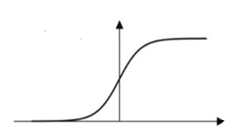









XOR Problem: Solution by Multi-Layer Perceptron
$$X_{2}$$
h₁ = (x₂ AND (NOT x₁))
h₂ = (x₁ AND (NOT x₂))
y = (h₁ OR h₂)
NOT (x) = 1-x
Sigmoidal nonlinearity is used as activation function.
h₁ = σ((1- x₁) + x₂) = σ((-1) x₁ + x₂ + 1)
h₂ = σ(x₁ + (1- x₂)) = σ(x₁ + (-1) x₂ + 1)
y = σ(h₁ + h₂) = σ(h₁ + h₂ + 0)
A multi layered perceptron (MLP) with the proper weights can predict the output of a XOR logical operator.
$$X_{1}$$
XOR representation
(Linear non-separable task)
X | Y | O/P
0 | 0 | 0
0 | 1 | 1
1 | 0 | 1
1 | 1 | 0
$$x_{1}$$
$$h_{1}$$
XOR
1
$$S\left(Z\right)= \frac{1}{1+e^{−Z}}$$
Input Layer
Hidden Layer
y
0.5
Output Layer
-$∞$
0
Z
$$x_{2}$$
$$h_{2}$$
+$∞$
XOR Logic
Sigmoid Function
XOR(x,y)=x’y+xy’

Slide 4
Multi-Layer Perceptron
MLP (with one or more hidden layers): The strength of a Multi-Layer Perceptron (MLP) lies in its hidden layers.
Neurons in the first hidden layer create multiple hyperplanes that partition the input space into several half-spaces.
Neurons in the following hidden layers combine these half-spaces to form more complex regions.
The intersections of these half-spaces produce convex regions, such as polygons in two dimensions or polytopes in higher dimensions.
The output layer combines these convex regions through unions, enabling the formation of complex decision boundaries that may be non-convex or even disconnected.
This capability to construct intricate piecewise-linear decision boundaries makes MLPs universal approximators, allowing them to approximate any continuous function when provided with enough hidden neurons and suitable activation functions.
Input Layer
Output Layer
MLP with single hidden layer
Hidden Layer

Slide 5
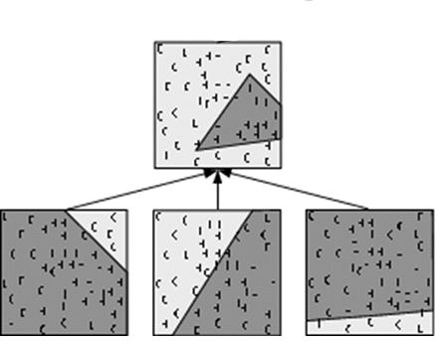
Multi-Layer Perceptron (MLP)
Input Layer
Output Layer
MLP with single hidden layer
Hidden Layer
Figure¹: Partitioning of the input space by linear threshold-nodes in a MLP with hidden layer, one output node, an examples of separable decision regions.
[1] Crone, Sven & Soopramanien, Didier. (2005). Predicting Customer Online Shopping Adoption - an Evaluation of Data Mining and Market Modelling Approaches.. Proceedings of the 2005 International Conference on Data Mining, DMIN'05. 215-221.

Slide 6













Introduction to Multi Layer Perceptron(MLP)
$$I_{0}$$
$$I_{1}$$
$$I_{l}$$
$$I_{m}$$
Input Layer
$$h_{11}$$
$$h_{1e}$$
$$h_{1n}$$
Hidden Layer with n No. of neurons
$$w_{ei}$$
k no. of hidden layers
$$h_{k1}$$
$$h_{ki}$$
$$h_{kr}$$
Hidden Layer with r No. of neurons
$$Y_{1}$$
$$Y_{2}$$
Output Layer

Slide 7
Introduction to Multi Layer Perceptron(MLP)
Input Layer
Acts as the entry point of the network.
Simply receives the input features and forwards them to the next layer without performing any computation.
Hidden Layer(s)
Process the input data and learn underlying patterns.
Allow the network to solve problems that cannot be separated by a single linear boundary.
Even a single hidden layer can represent complex relationships, while additional hidden layers increase the network's ability to approximate highly complex functions with greater accuracy.
Output Layer
The final processing layer of the network.
Combines the learned information from the hidden layers and generates the predicted output.

Slide 8



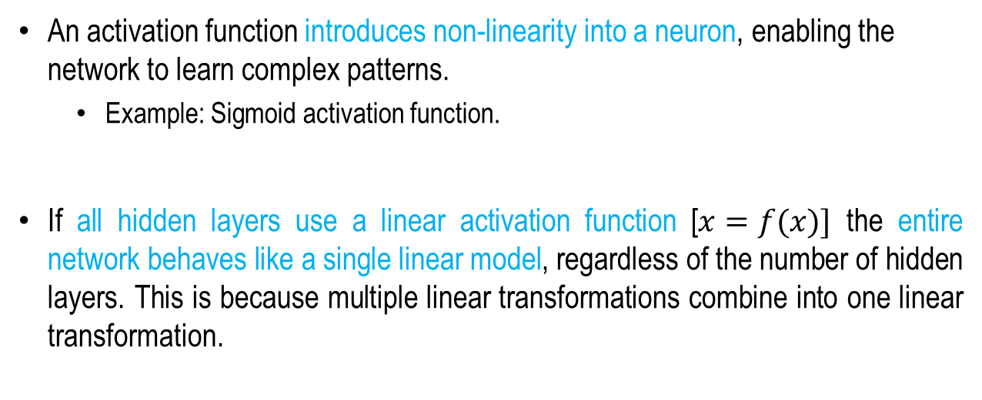



Activation Function
An activation function introduces non-linearity into a neuron, enabling the network to learn complex patterns.
  Example: Sigmoid activation function.
If all hidden layers use a linear activation function [$x=f(x)]$ the entire network behaves like a single linear model, regardless of the number of hidden layers. This is because multiple linear transformations combine into one linear transformation.
$$f(x)$$
$$x=f(x)$$
$$x$$
Linear Function
1
$$S\left(Z\right)= \frac{1}{1+e^{−Z}}$$
Sigmoid Activation Function
Logistic function with output between 0 and 1.
Commonly used for binary classification.
Differentiable but prone to the vanishing gradient problem.
0.5
-$∞$
0
Z
+$∞$
Sigmoid Function

Slide 9
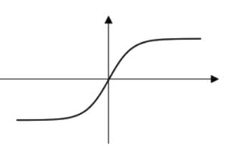
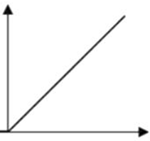
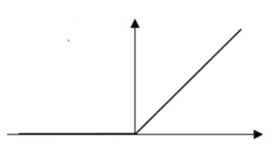





Activation Function
Hyperbolic Tangent (tanh)
Shifted version of the sigmoid function.
Differentiable.
Suffers from the vanishing gradient problem.
ReLU (Rectified Linear Unit)
Faster and computationally efficient.
Reduces vanishing gradient for positive inputs.
Can suffer from the "dying ReLU" problem for negative inputs.
Leaky ReLU
Variant of ReLU.
Allows a small gradient for negative inputs.
Helps overcome the dying ReLU problem.
+1
Z
$$tanh⁡(Z)$$
$$max⁡(0.1Z,Z)$$
-$∞$
0
+$∞$
$$max⁡(0,Z)$$
Z
-1
Z
tanh Function
Leaky ReLU Function
ReLU Function

Slide 10

Softmax Activation Functions
The Softmax function is commonly used in the output layer of neural networks for classification tasks. It transforms raw output scores (logits) into probability values by normalizing them, ensuring that all outputs lie between 0 and 1 and their sum equals 1.
Converts logits into probabilities.
Output values range from 0 to 1 and sum to 1.
Used in the final layer of classification networks.
Suitable for multi-class classification, where exactly one class is chosen as the prediction.
Input layer
Hidden Layer
(1.3) (5.2) (2.1) (0.7) (1.1) (1.2)
Output Layer
$$\frac{e^{zi}}{\sum_{j=1}^{k}{e^{zj}}}$$
Softmax Activation Function
Output Probabilities
(0.02) (0.90) (0.04) (0.01) (0.01) (0.02)

Slide 11
















MLP with Multiple Hidden Layers
Let the MLP has k no. of hidden layers p is the layer index. For input layer p=0:
b=1
$$I_{1}$$
$$I_{l}$$
$$I_{m}$$
Input Layer
$$(h^{0}(I)=I)$$
Layer pre-activation for k>0
$$h_{1e}$$
$$h_{11}$$
$$h_{1n}$$
Hidden Layer with n No. of neurons
$$a^{(p)}\left(I\right)= b^{(p)}+W^{(p)}h^{(p−1)}(I)$$
b=1
$$w_{ei}$$
k no. of hidden layers
Hidden layer activation p=1 to k
$$h_{k1}$$
$$h_{ki}$$
$$h_{kr}$$
Hidden Layer with r No. of neurons
$$h^{p}\left(I\right)=g(a^{p}\left(I\right))$$
Output layer activation p= k+1
$$Y_{1}$$
$$Y_{2}$$
Output Layer
$$h^{(k+1)}\left(I\right)=o\left(a^{\left(k+1\right)}\left(I\right)\right)=f(I)$$

Slide 12
Summery
Introduction to Multi-Layer Perceptron
Activation Function
Softmax Activation Function

Slide 13
Neural Network Fundamentals
Next
Lecture 3: Part 3
Generative AI for Computer Vision

